Slide 1
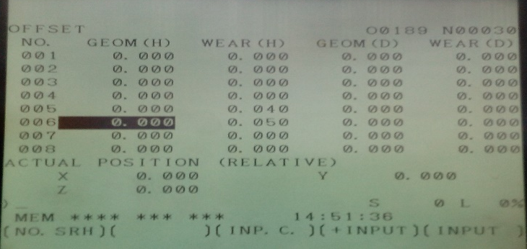
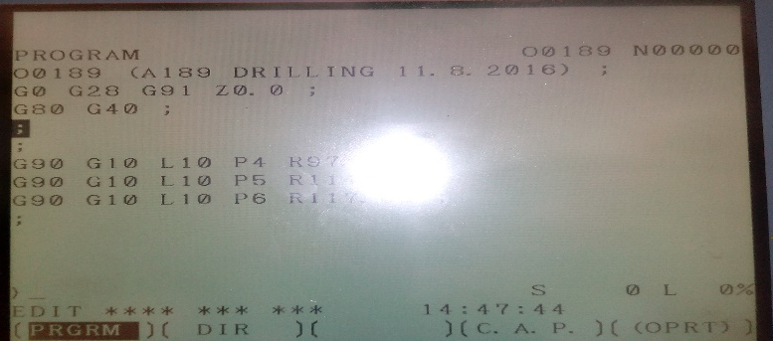
P15
TPM CIRCLE NO :- 01
ACTIVITY
KK
QM
PM
JH
SHE
OT
DM
E&T
KAIZEN IDEA SHEET
TPM CIRCLE NAME: Achiever
LOSS NO. / STEP
DEPT :- MACHINE SHOP
RESULT AREA
P
Q
A
B
C
D
S
M
CELL:-
CELL NAME:-Drum cell
MACHINE / STAGE :- DRILL MACHINE
OPERATION :- DRILLING
KAIZEN THEME:- PCP drill depth oversize due to tool offset data save offset .
IDEA :-All tool offset input in program
PROBLEM PRESENT STATUS :- Offset change without information by operator so may be accident drill depth problem
COUNTERMEASURE:-
1. All tool offset input in program so every time run program read compulsory offset
BENCHMARK
MINOR
TARGET
0
KAIZEN START
15.08.2016
TDC
26.08.2016
KAIZEN FINISH
26.08.2016
TEAM MEMBERS :-Santosh Wakchaure,
Walunj,vinod,amol,SUTAR
BENEFITS :-
Lock tool offset .zero operator mistake .zero accident
Before
After
KAIZEN SUSTENANCE
WHY - WHY ANALYSIS :-
Why1 :- Offset change without information
Why2 :- By operator mistake
Why3 :- Tool offset command in program for tool height offset
RESULT :-
Eliminate Unsafe condition
WHAT TO DO:-.
HOW TO DO:-
FREQUENCY :- .
SCOPE & PLAN FOR HORIZONTAL DEPLOYMENT
Sr No | CELL | TDC | RESP. | STATUS
1
2
ROOT CAUSE : Tool offset command input for special tool height offset
REGISTRATION NO. & DATE : 18.1.2017
REGISTERED BY :- Manoj Kumar
MANAGER’S SIGN :- d y pawar

